Slide 1
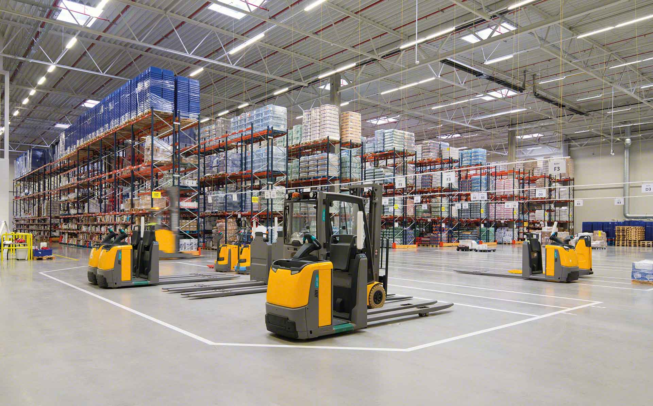

Material Handling KPI
November 2022

Slide 2
Material Handling moves
Row Labels | Sum of CYCLE COUNTS | Sum of MAT HANDLE | Sum of TOTAL
amiranda | 4 | 1031 | 1035
judelato | 0 | 852 | 852
erojas | 1 | 775 | 776
jtobias | 9 | 755 | 764
jodelacr | 7 | 568 | 575
Grand Total | 21 | 3981 | 4002
Total movements
4002

Slide 3
Adjustments
Row Labels | Sum of COST | Count of PART
amiranda | 114.26 | 4
erojas | 2086.9 | 1
jodelacr | -85.27 | 7
jtobias | 1008.55 | 8
Grand Total | 3124.44 | 20
Adjustments difference
$3124.44

Slide 4
Labor intensive
Class not slotted count
8
Labor Intensive
16

Slide 5
restock
Row Labels | Count of Part Number
Dec
1-Dec | 50
2-Dec | 44
5-Dec | 79
6-Dec | 64
7-Dec | 41
8-Dec | 60
9-Dec | 61
12-Dec | 85
13-Dec | 57
14-Dec | 29
15-Dec | 47
16-Dec | 52
19-Dec | 70
20-Dec | 32
21-Dec | 22
22-Dec | 34
23-Dec | 47
27-Dec | 66
28-Dec | 36
29-Dec | 40
30-Dec | 34
Grand Total | 1050
Part Numbers stocked
1050

Slide 6
Empty locations
Row Labels | Sum of Total de espacios disponibles
Dec
5-Dec | 350
12-Dec | 328
19-Dec | 255
23-Dec | 296
28-Dec | 295
Grand Total | 1524
Actual empty locations
295

Slide 7
Discrepancies
Date | Sum of Locaciones
sep | 78
02-sep | 25
05-sep | 15
16-sep | 15
23-sep | 10
30-sep | 13
oct | 27
07-oct | 5
14-oct | 0
28-oct | 9
31-oct | 13
nov | 35
02-nov | 12
04-nov | 5
08-nov | 2
11-nov | 4
14-nov | 4
17-nov | 3
22-nov | 5
25-nov | 0
Grand Total | 140
Total discrepancies
0

Slide 8
Consolidation
Row Labels | Sum of count of consolidations
14/08/2022 | 27
28/09/2022 | 24
06/10/2022 | 35
13/10/2022 | 26
20/10/2022 | 20
27/10/2022 | 29
17/11/2022 | 18
24/11/2022 | 15
Grand Total | 194
Total Consolidations
194

